Slide 1
MyLivingCity
Project Report
Muyuan Ma
Zihao Huang
Yushun Cheng

Slide 2
Contents
Objective
Comment Funnel Function
Input Filtering System
Gauge Statistics & Display Dashboard
Summation Comment Display
Integration & API Setup
Limitation
Future Development

Slide 3
Objective
Enhance community interaction experience
Improve feedback analysis
Ensure respectful discussion
Measure community opinion effectively

Slide 4
Comment Funnel Function
Dataset comparing
 | YouTube Comment | MyLivingCity Comment
Categorical | Each video is a topic | Each discussion group is a topic
Length | Most comments are just one or two sentences | Limit comment length on the front-end
Diversity | Contains Internet slang, Emoji, etc. | -
 | Comments with the same or opposite opinions under the same topic
 | 718,745 rows in GBcomment.csv & 691,723 rows in UScomment.csv

Slide 5
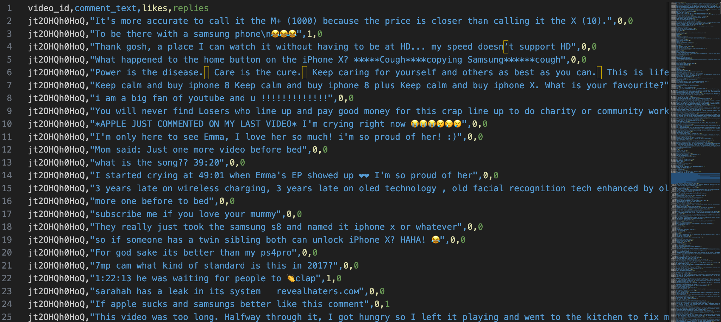
Comment Funnel Function
Dataset overview

Slide 6
Comment Funnel Function
Processing Flow
Sentiment Analysis
Comments
Model
(LLaMA3)
keywords…
Database
Cross Comparison

Slide 7
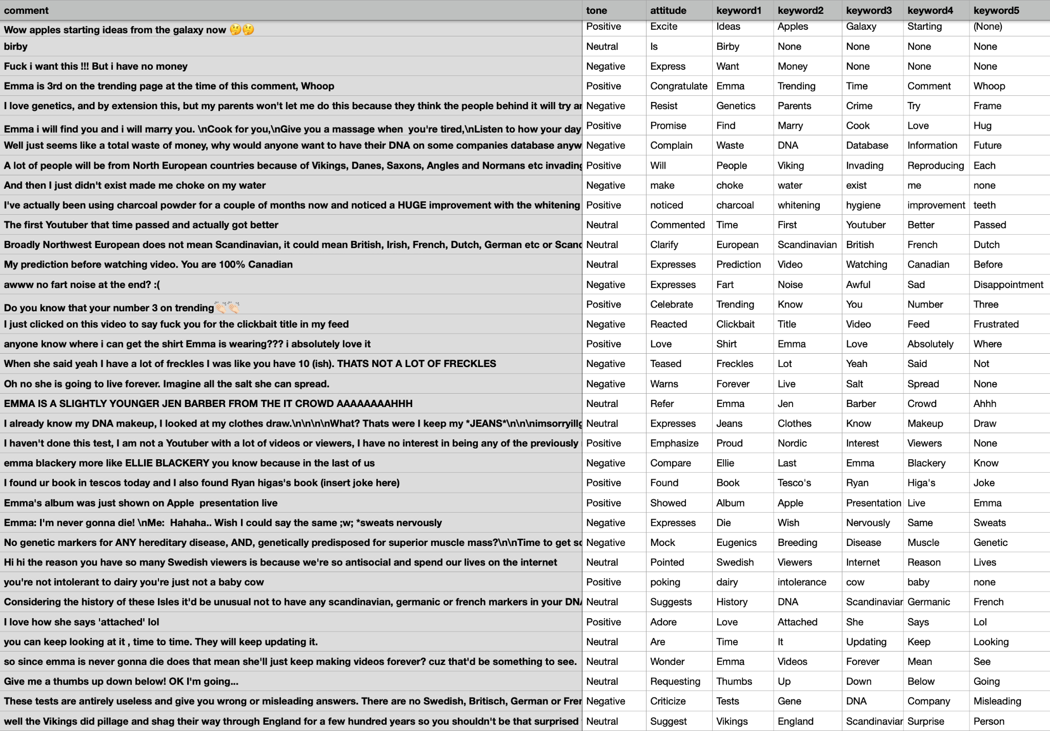

Slide 8
Comment Funnel Function
Model Performance
Stable and with outstanding performance
Accurately extract information from a small amount of text
Understand informal terms
Internet slang
Emoticons and Stickers
Emoji

Slide 9
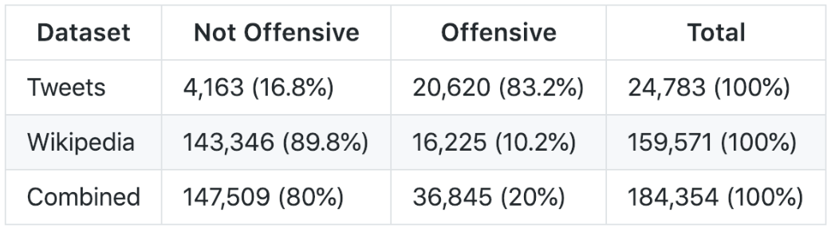
Input Filtering System
Data(hand-labeled by humans):
twitter dataset & wikipedia comments dataset

Slide 10
Input Filtering System
Vectorization: Bag of Words(turns any text string into a vector by counting how many times each given word appears)
Example: “I am swimming, I am happy.”
I | am | swimming | happy
2 | 2 | 1 | 1

Slide 11
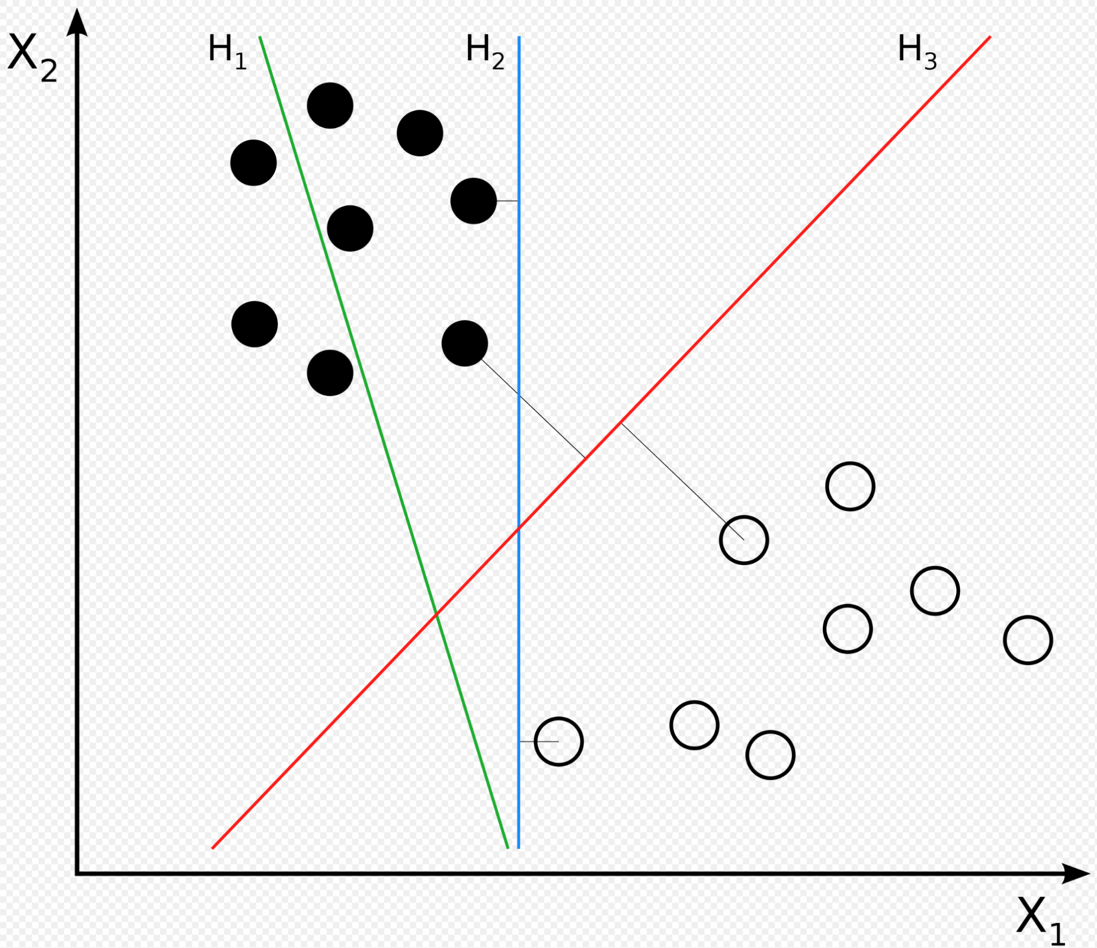
Input Filtering System
Linear Support vector machine(SVM)
The model learns which words are “bad” and how “bad” they are because those words appear more often in offensive texts. It’s as if the training process is picking out the “bad” words itself, which is much better than using a fixed wordlist.
Source: Wikipedia(Svm separating hyperplanes)

Slide 12
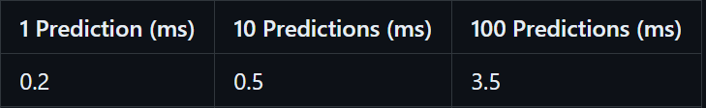
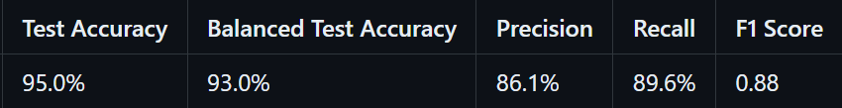
Input Filtering System
Highlights:
Fast and robust
Simple structure, easy to setup or modify according to future demand
No bad word list required, learns by itself
Smarter and more flexible than Regular Expression

Slide 13
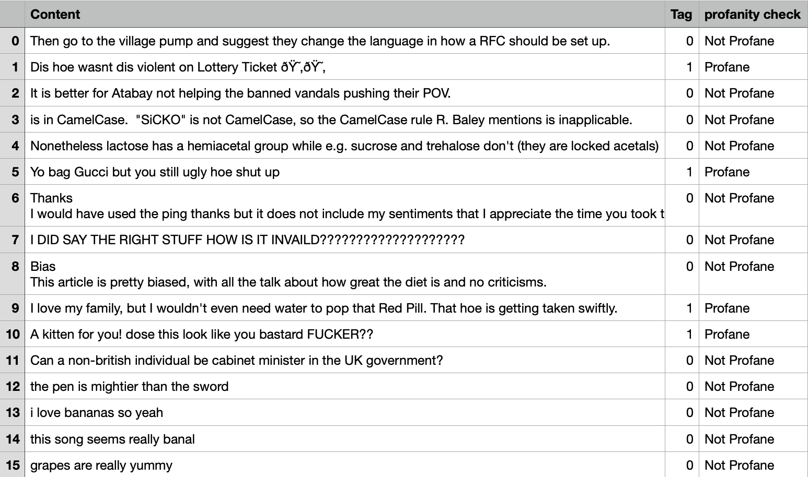

Slide 14
Summary Comment Display
Processing Flow
Comments
(combination)
Topic
Matching
Model
(LLaMA3)
Summarization
Database

Slide 15
Summary Comment Display
Results
The video appears to be about iPhones, with many commenters sharing their opinions and experiences. Some praise Apple's products, while others criticize them or compare them to Samsung phones. There are also mentions of Steve Jobs and Wozniak, as well as jokes and sarcasm about the cost of iPhones.
The video discusses DNA test results and their accuracy. Viewers share their own experiences with DNA tests, including finding Scandinavian heritage and being related to celebrities like Emma herself. The comments also touch on topics like genetic health risks, false information from certain testing labs, and personal preferences for furniture.
The comments section of this video is filled with diverse reactions, including laughter, relatability, and confusion. Some users appreciate the humor, while others find it annoying or not funny at all. There are also comments that stray off-topic, share personal stories, or promote other YouTube channels or products.

Slide 16


Integration & API Setup
Limited by server performance,
API is a better way to deploy the functions.
The low price allows us to summarize more than 2,000 comments for only $0.08.

Slide 17
Limitation
Data Difference
Model Generalizability
The Use of Demo Data
Model Adaptability
Real-time Performance

Slide 18
Future Work
Model update and data cleaning
As more comments from the MyLivingCity platform are added, we can use them to fine-tune the model.
The data visualization part can also be further subdivided as the amount of data increases.
Try local deployment.

Slide 19
Thank you

